Slide 1
Data, Environment and Society Lecture 7: Visualization
September 19, 2019
Instructor: Duncan Callaway
GSI: Salma Elmallah

Slide 2
Announcements
Kammen lecture will be moved (not next Thursday, stay tuned)
HW2 due today
HW3 released today
We will be posting polls to get feedback on homework, lecture and labs, stay tuned.

Slide 3
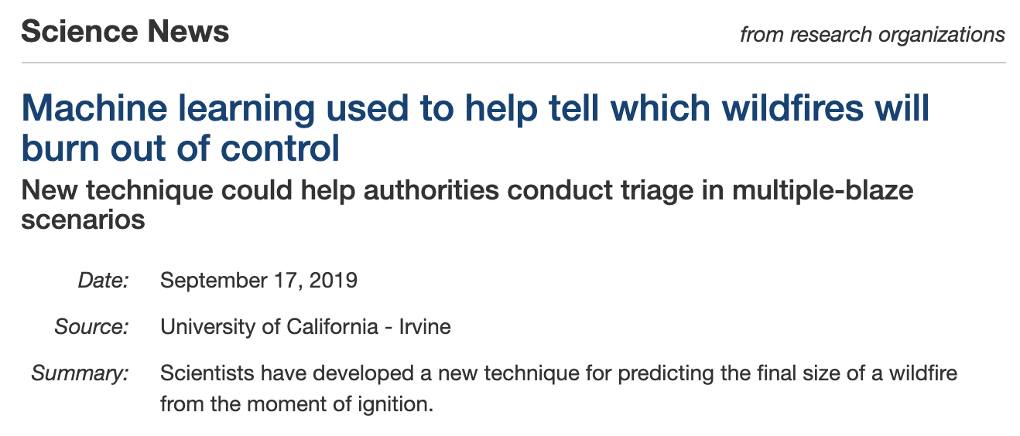
Notes:
Before we get into lecture – a little segue about machine learning in the news
https://www.sciencedaily.com/releases/2019/09/190917133052.htm

Slide 4
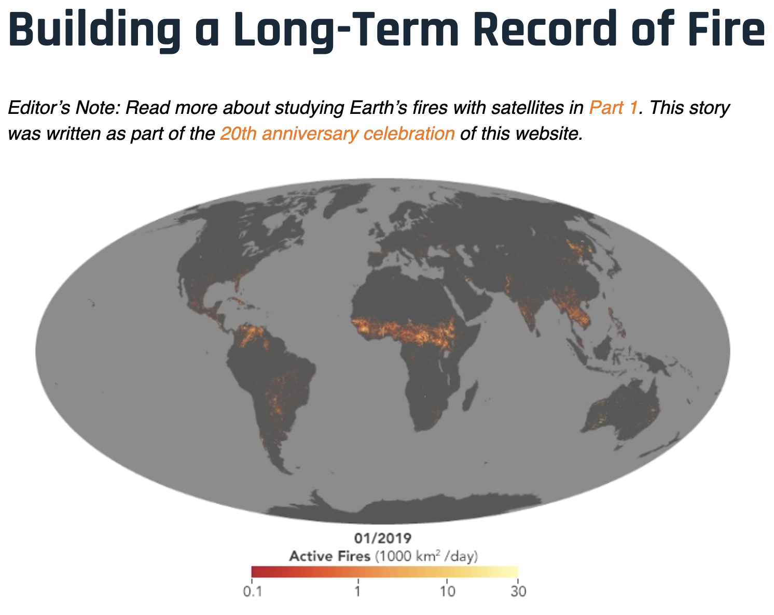
Notes:
https://www.sciencedaily.com/releases/2019/09/190917133052.htm

Slide 5
Outline
Principles of visualization – develop an understanding of what factors to consider as you make a new plot
Types of plots – building a library of ways to consider plotting your data
Throughout, (hopefully) have fun looking at cool charts.

Slide 6
Let’s just look at some cool pictures
What jumps out quickly?
What did the creator do to make it easier for you to understand their story?
How many categories of data are displayed in a two dimensional plot?

Slide 7
Notes:
They key addition here is dates, in text.
without it this graph would be very misleading!

Slide 8
Notes:
What jumps out? Creator used color, lineweight, text to give meaning to the figure.
* colors give categorical data
* names labeled
* detail blurred where unimportant
* bold where they want to make a point.

Slide 9
Notes:
The important most important point I want to make here is that all figures are on same scale

Slide 10
Notes:
What do you notice in this image? I’m most drawn to
- color highlights
- text labels
- many categories together -- can see trends quickly

Slide 11
Notes:
time vs score enhanced by
- use of color
- text labels
- different symbols

Slide 12
Napoleon
Notes:
how many dimensions / variables displayed?
* location in space
* direction of travel
* number of troops
Temperature
time

Slide 13
Principles of visualization
Scale
Conditioning
Perception
Transformation
Context
Smoothing

Slide 14
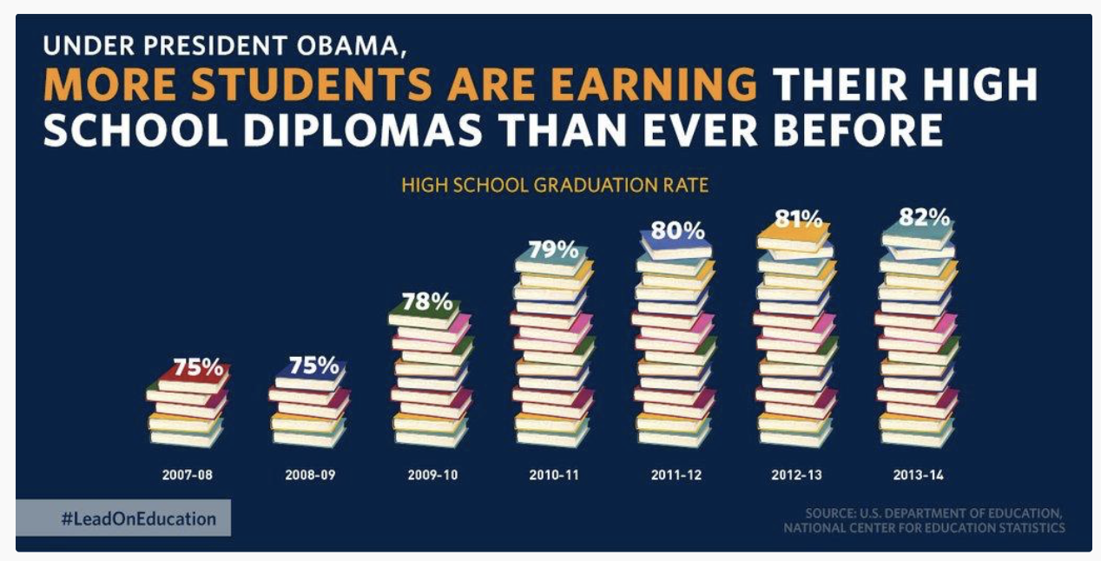
Scale
How would you fix this chart?

Slide 15
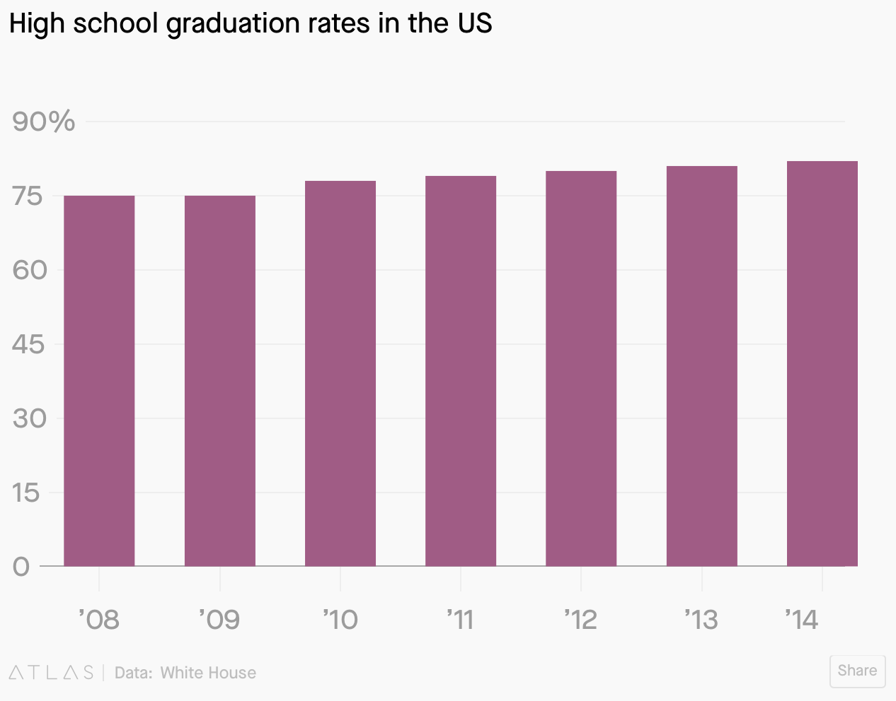
Scale, ctd
Fixed?
Not necessarily – though y-axis starts at zero (often a good thing) what we really want to know is how things are changing over time.

Slide 16
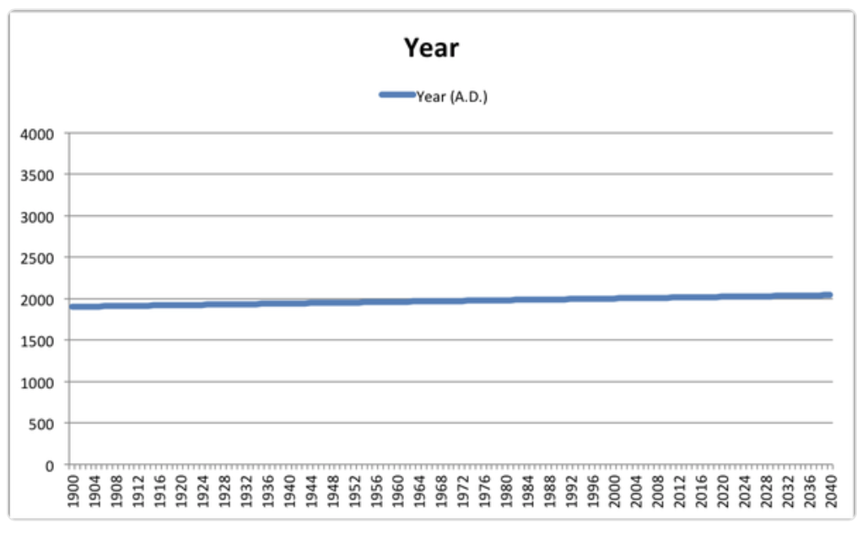
Scale: we shouldn’t always start at zero…
Notes:
Yahoo finance produced this figure (but anyone could if they wanted to spend a minute of their own time doing it)

Slide 17
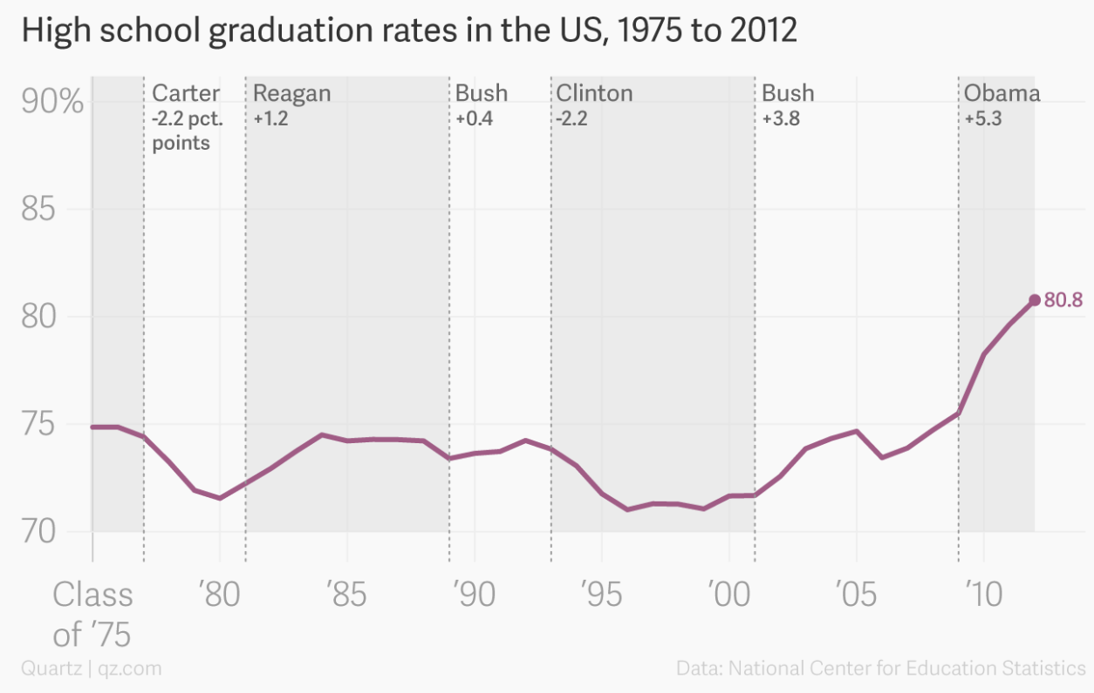
Scale, ctd
Education plot fixed?
We see comparisons to other administrations
We see changes over a longer period of time
(note, these data are from a slightly different data set than the data in the first two graduation charts)

Slide 18
Principles of visualization
Scale
Conditioning
Perception
Transformation
Context
Smoothing

Slide 19
Conditioning
What does conditioning mean, in the context of visualization?
To subgroup the data to see relationships between different groups of interest

Slide 20
Conditioning example
Taken from Callaway, Fowlie and McCormick JAERE (2018)
Notes:
Taken from Callaway, Fowlie and McCormick JAERE (2018)

Slide 21
Revisiting Julia
Notes:
time vs score enhanced by
- use of color
- text labels
- different symbols

Slide 22
Principles of visualization
Scale
Conditioning
Perception
Transformation
Context
Smoothing

Slide 23
Perception
Some principles:
We perceive some colors more strongly than others (especially greens)
We perceive lighter shaded areas as larger than darker shaded ones.
An under-appreciated issue: color-blindness.

Slide 24
What might you change to adjust perception?
Notes:
Colors
We perceive red more strongly – eyes drawn there
..but yellow looks bigger.

Slide 25
Not color blind

Slide 26
Color blind

Slide 27
Perceptually uniform Color palettes – quantitative data
Perceptually uniform: equal steps in data are perceived as equal steps in the color space
A few perceptually uniform matplotlib color maps
Good when you want to represent a quantity in space

Slide 28
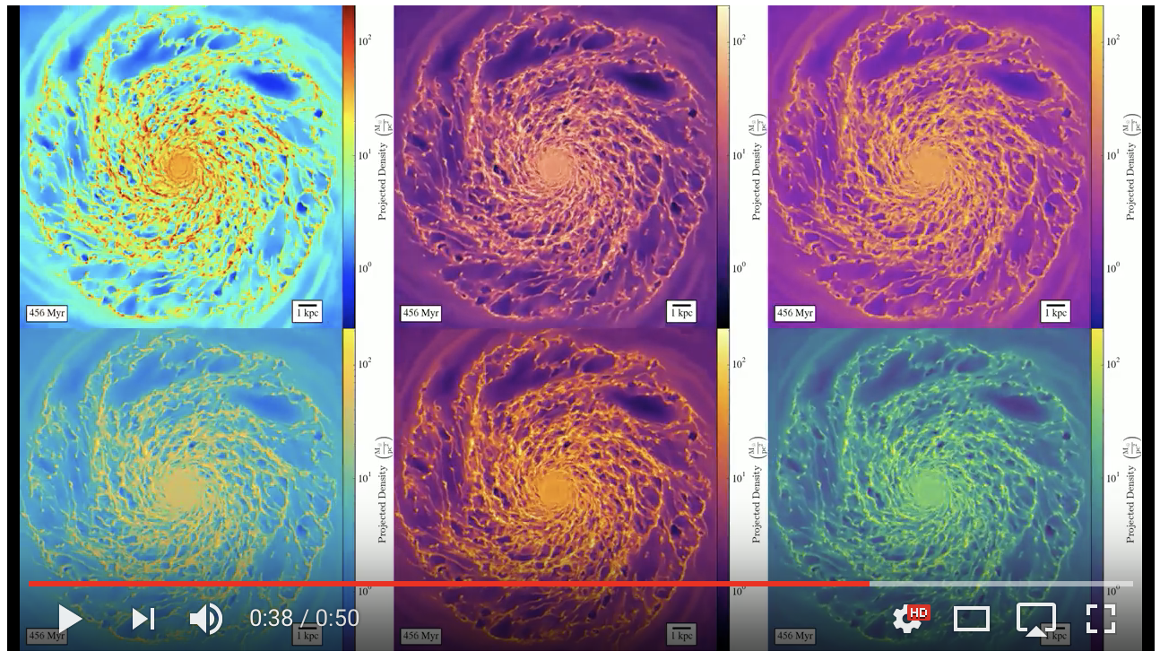
jet
magma
plasma
parula
inferno
viridis
Nathan Goldbaum's galaxy formation simulation video
Notes:
jet

Slide 29
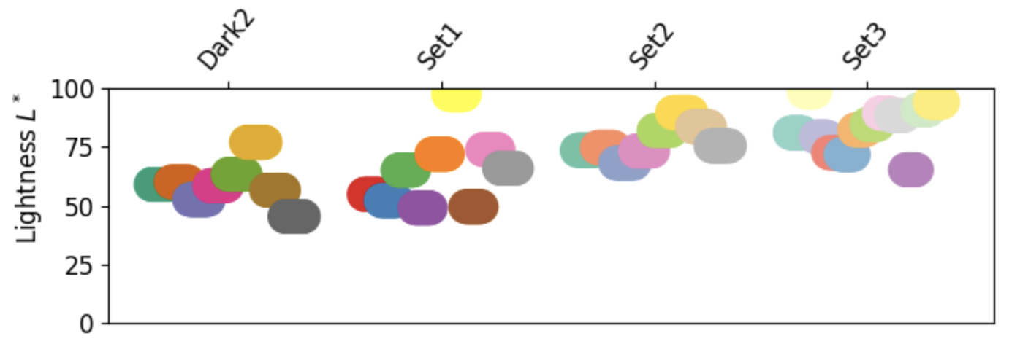
Qualitative / categorical colormaps
Often used for representing quantity in an area or line – colors distinguish between different categories rather than quantities.
A few matplotlib quantitative colormaps:

Slide 30
Example: Set3 palette for categorical data
https://vincent.readthedocs.io/en/latest/charts_library.html

Slide 31
Notes:
rank vs time. What’s good?
- color highlights
- text labels
- many categories together -- can see trends quickly

Slide 32








Colormap summary
Consider for displaying quantitative variables like temperature, concentration, etc
plasma,
viridis,
inferno,
magma
Consider for displaying categorical data
set1,
set2,
set3,
dark2

Slide 33
Principles of visualization
Scale
Conditioning
Perception
Transformation
Context
Smoothing

Slide 34
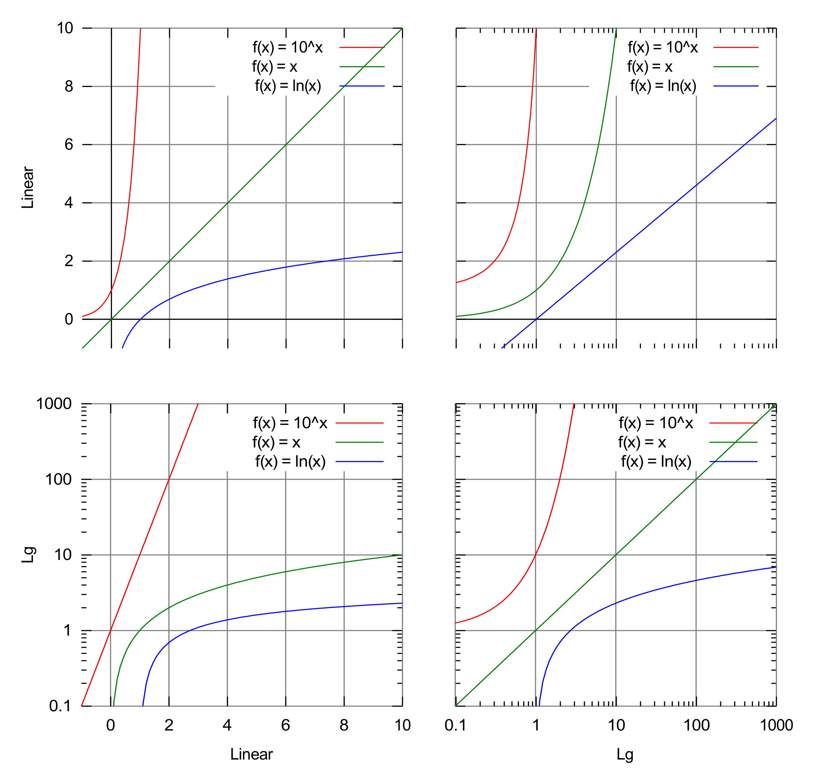
Transformation
Log transform is the “swiss army knife” transformation
Squashes down big numbers; makes it easier to see small numbers on the same axis.
By Autopilot - Own work, CC BY-SA 3.0, https://commons.wikimedia.org/w/index.php?curid=10733854

Slide 35
Power laws

Slide 36
Principles of visualization
Scale
Conditioning
Perception
Transformation
Context
Smoothing

Slide 39
Notes:
* colors give categorical data
* names labeled
* detail blurred where unimportant
* bold where they want to make a point.

Slide 40
Notes:
nice representation of time -- without it this graph would be very misleading!
Dates provide context, which is nice.

Slide 41
Types of plots

Slide 42
Plot types we’ll talk about today
Distributions:
Rugplot
Histogram
Kernel density
Box and whisker
Scatter plots
Line plots
Bar charts
Three dimensional plots
Geographic maps
Heat maps, contour maps
Scatter plots

Slide 43
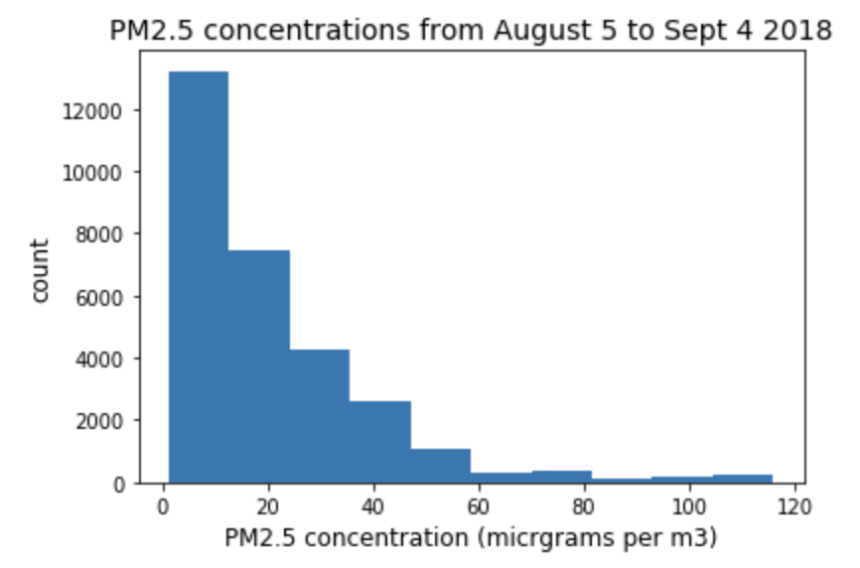
Histograms
Plots count (number of observations) versus a single variable
Here, same distribution at rug plot on previous slide
Ecole Bilingue data from PurpleAir

Slide 44
Smoothing with kernel density estimates
Start with a set of values spread on the x-axis (here just three)
Put a Gaussian distribution over each one
Add up the Gaussian distributions, then re-scale so the area under the curve is 1
Notes:
Start with a set of values spread on the x-axis (here just three)
Put a kernel (in this case, a Gaussian distribution) over each one.
Add up the Gaussian distributions, then re-scale so the area under the curve is 1.
Note that you can choose a variety of kernels, not just gaussian. But they must be the same area and you must re-scale so the total area adds to 1.

Slide 45
Why normalize the kernel density estimate curve so the area = 1?
The KDE is an estimate of the probability distribution of values in the population
Definition of the probability distribution is that the probability of an event happening in a particular range is the integral of the curve over that range
Total probability can’t be greater than one, so we normalize.

Slide 46
The KDE “bandwidth”
We can vary the width of the Gaussian distribution we overlay on each point. We call this width the bandwidth
What would be the effect on the final KDE plot or reducing or growing the bandwidth?
Small bandwidth
Large bandwidth

Slide 47
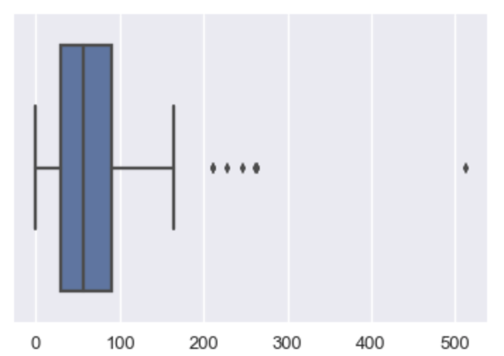
Box and whisker plots
“box”
Display similar information to a histogram, but abstracted:
Median
“Interquartile range” (IQR; 25th to 75th percentile)
Whiskers located (default)
1.5 times the IQR away from the 25th or 75th percentile, or
At the last data point on that side of the distribution
Data points more than 1.5 times the IQR away from the 25th or 75th percentile are shown individually
“whisker”
Notes:
“box”

Slide 48
Quick notes on box and whisker
Nice for comparing distributions
They gloss over a lot of detail
Parameter defaults are adjustable:
25th and 75th percentile → Xth and Yth percentile (you can choose)
Whiskers at 1.5 times IQR → Z times IQR, or Xth and Yth percentile (you can choose)
But most boxplots done with the standard parameter values we list here.

Slide 49
Same distributions, different ways to plot
DS100 textbook
Notes:
DS100 textbook

Slide 50
Scatter plots

Slide 51
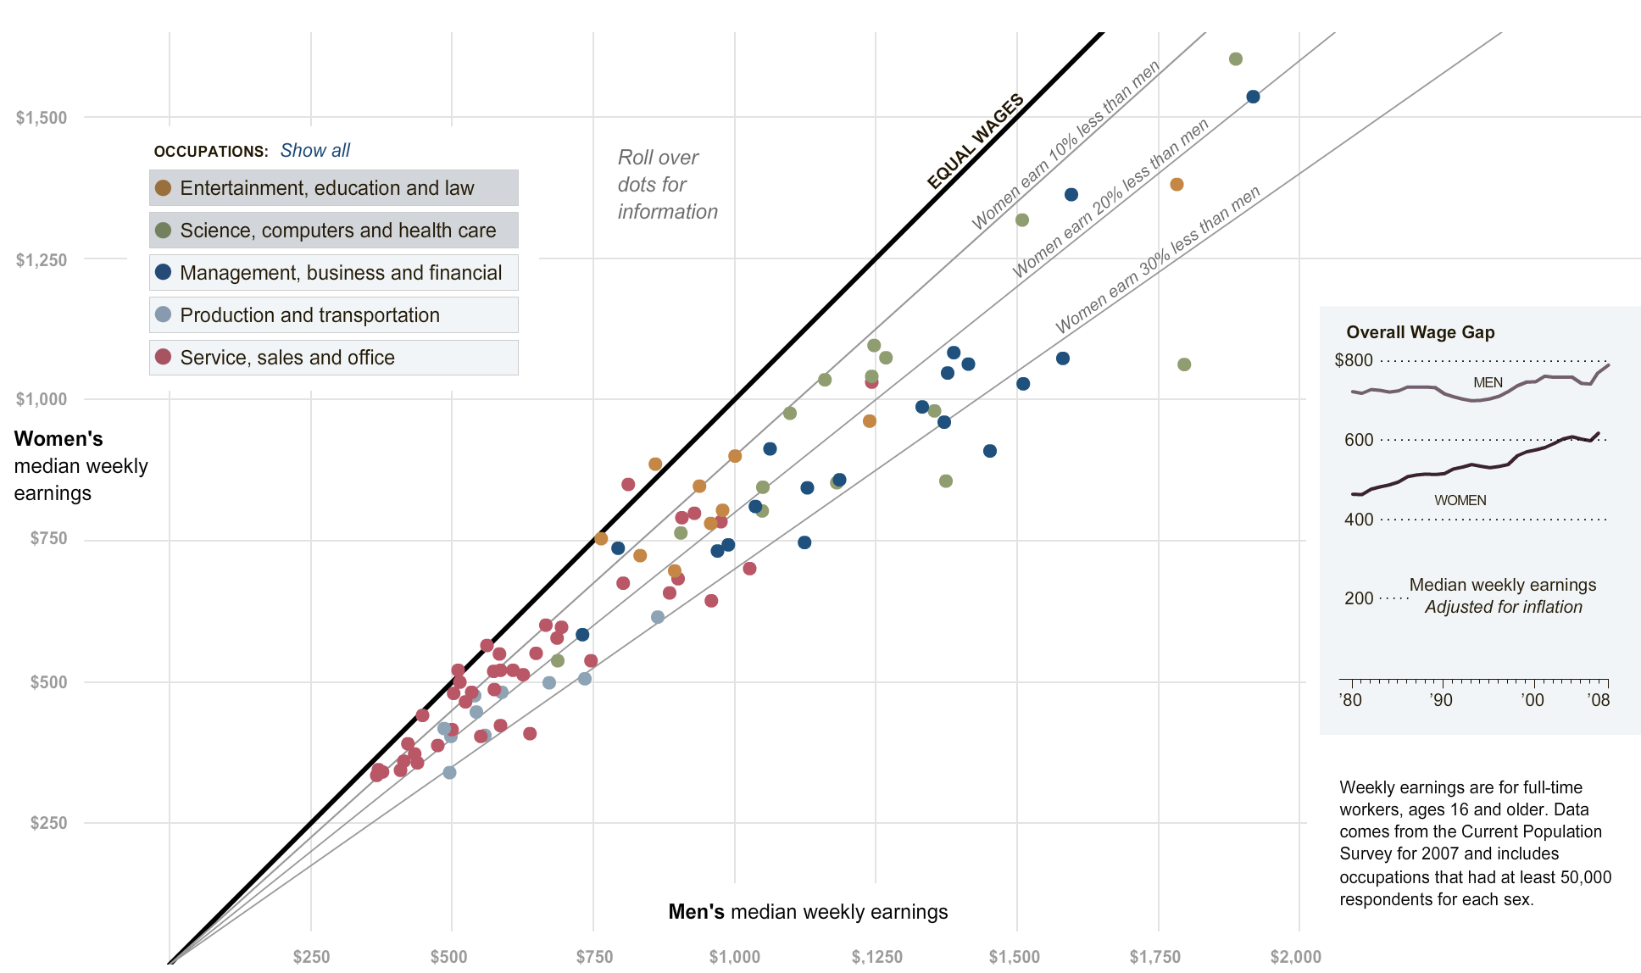
https://archive.nytimes.com/
Notes:
nytimes.com
What is the plot doing for scale, conditioning, perception, transformation, context and smoothing?

Slide 52
Scatter plots – things to adjust
Symbol shape → category
Symbol size → additional quantitative data
Symbol color → additional quantitative data or category
Labels → context

Slide 53
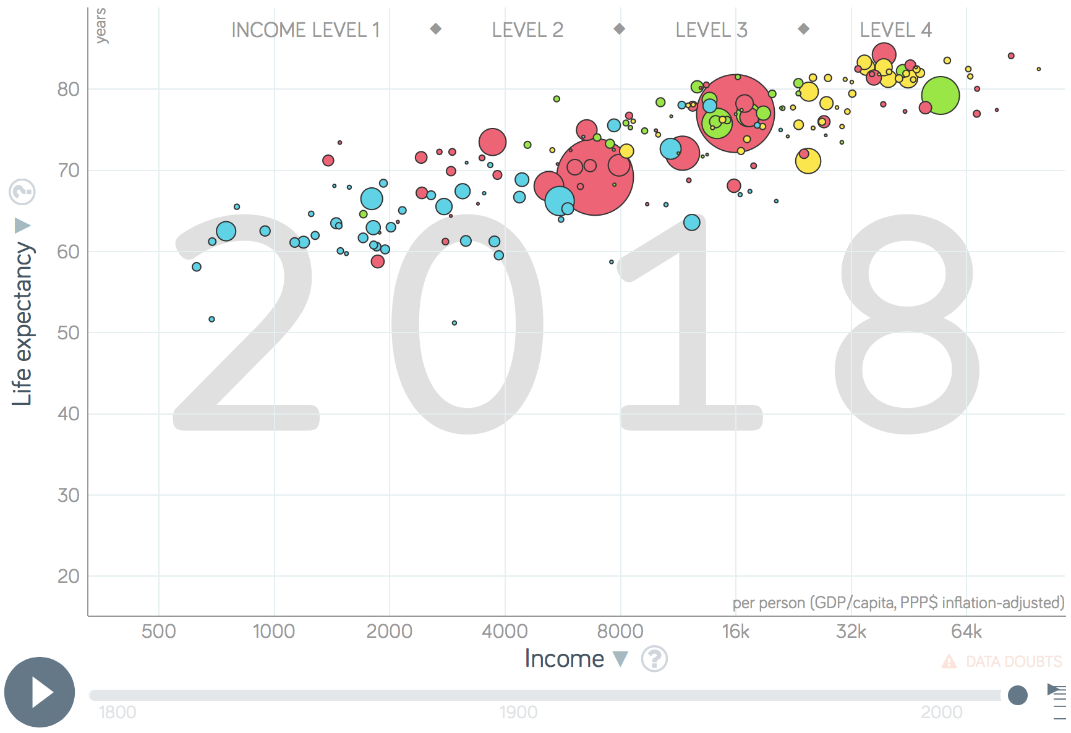
gapminder.org
Notes:
gapminder.org
What is the plot doing for scale, conditioning, perception, transformation, context and smoothing?

Slide 54
Line plots
Versus scatter, line plots connect measurements ”in order”
In cases where measurements are taken infrequently in time, this might help to visually interpolate what happened between measurements
It also gives a clear sense of sequence or correlation

Slide 55
538
Notes:
nice representation of time -- without it this graph would be very misleading!

Slide 56
Notes:
* colors give categorical data
* names labeled
* detail blurred where unimportant
* bold where they want to make a point.

Slide 57
Notes:
* All on same scale
* creative legend
* entertaining graphics

Slide 58
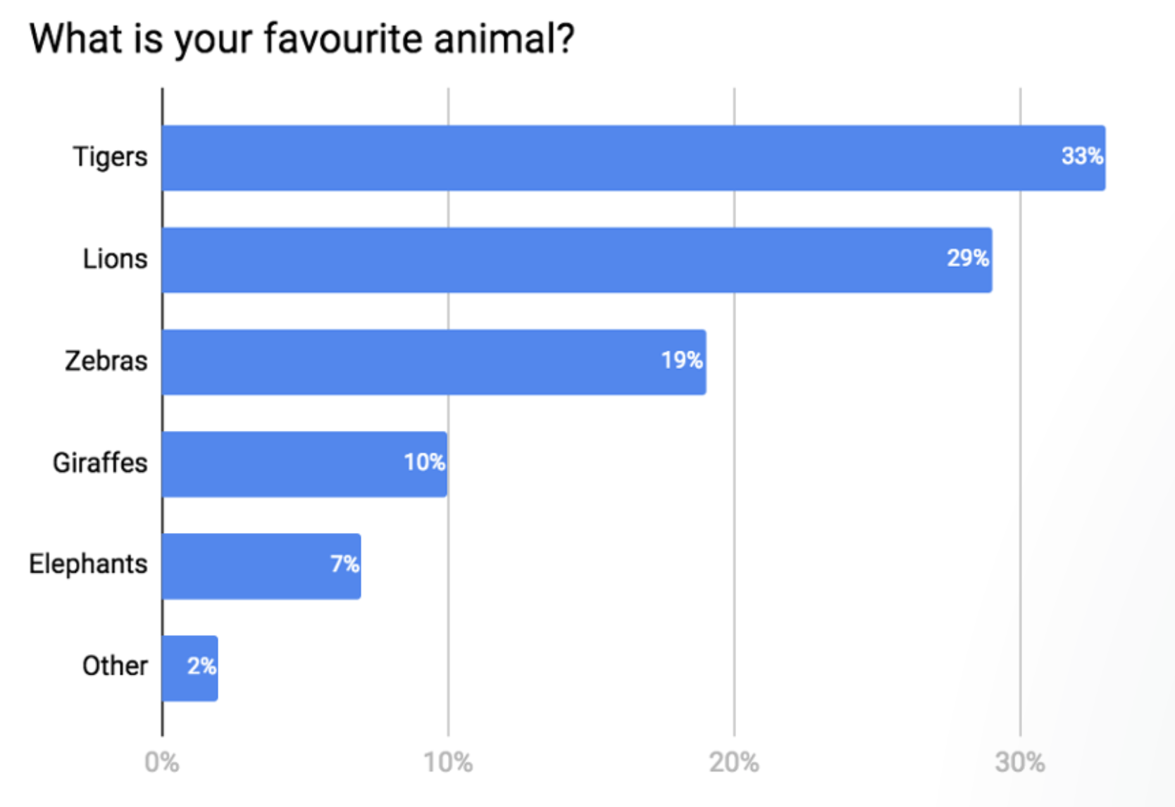
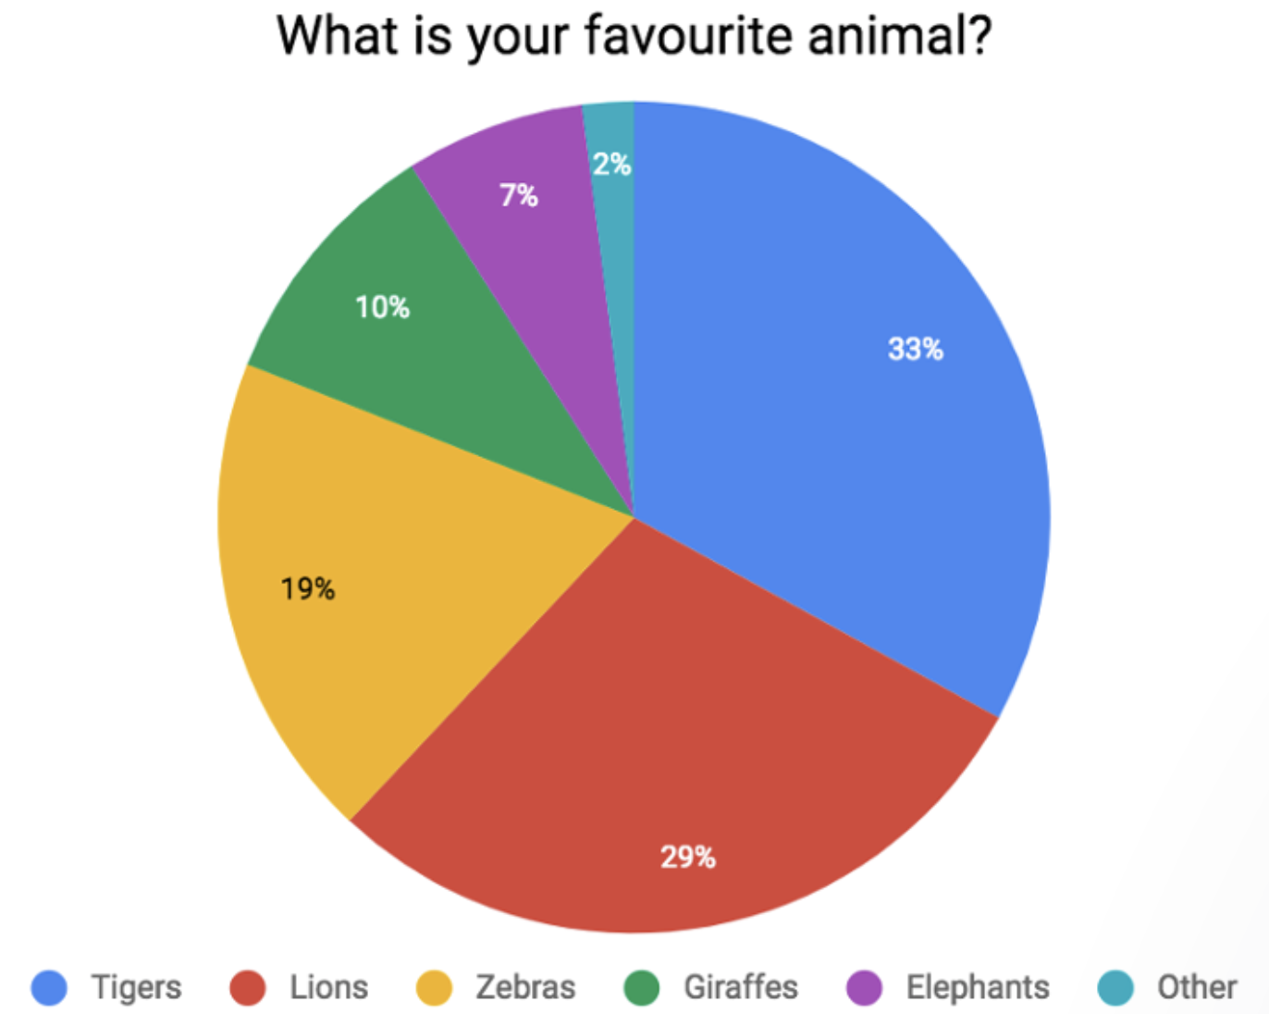
Bar charts
Display quantity of interest across many different categories.
You can do similar things with Pie charts, but they require comparing area (two dim.) which is harder than comparing length (one dim)
https://blog.funnel.io/why-we-dont-use-pie-charts-and-some-tips-on-better-data-visualizations

Slide 59
Conditioning Bar chart example
Notes:
Taken from Callaway, Fowlie and McCormick JAERE (2018)

Slide 60
Three (and more) dimensional data
Heat maps
Contour plots
Scatter plots with symbol size

Slide 61
Napoleon
Notes:
how many dimensions / variables displayed?
* location in space
* direction of travel
* number of troops
Temperature
time

Slide 62
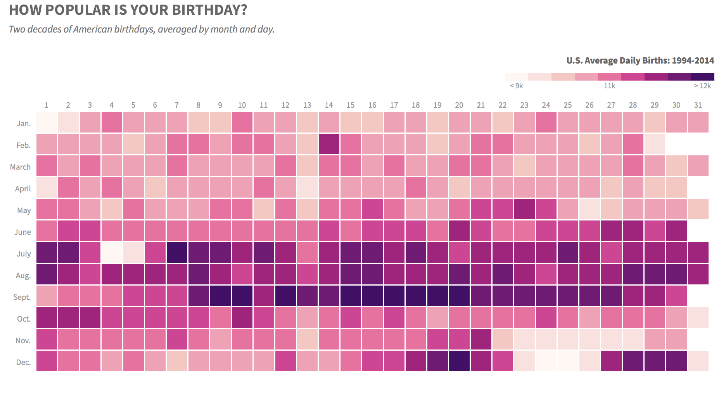
thedailyviz.com
Notes:
thedailyviz.com

Slide 63
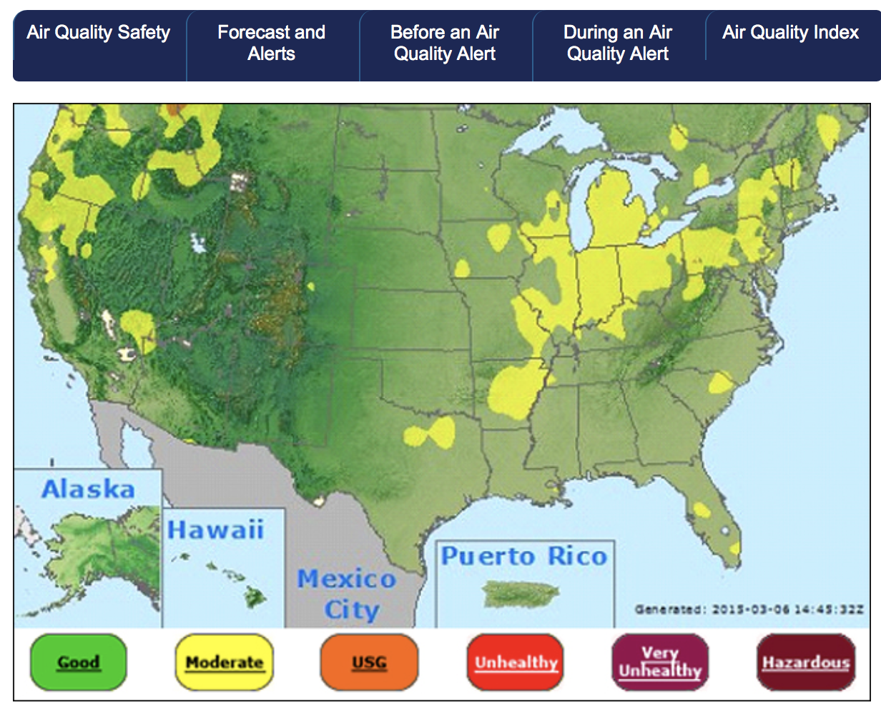

Slide 64
Customizing plots
Where to use text
At a minimum: x-label, y-label, title
Might also be relevant: legend, labeling features on the figure
Symbols on line and scatter plots
Colors – we’ve discussed already…
Line width – use your judgment
Font size
Title largest
Axis labels medium
Tick labels smallest
Font type
Use sans-serif!

Slide 65
Fonts
Should be readable in intended format
Paper: fonts can be 1-2 points less than text of paper
Presentations: fonts should be easily readable from back of room
Font type:
Serif font, Serif font
Sans serif font, Sans serif font
Best to use sans serif for figures

Slide 66
gapminder.org
Notes:
gapminder.org

